Slide 1
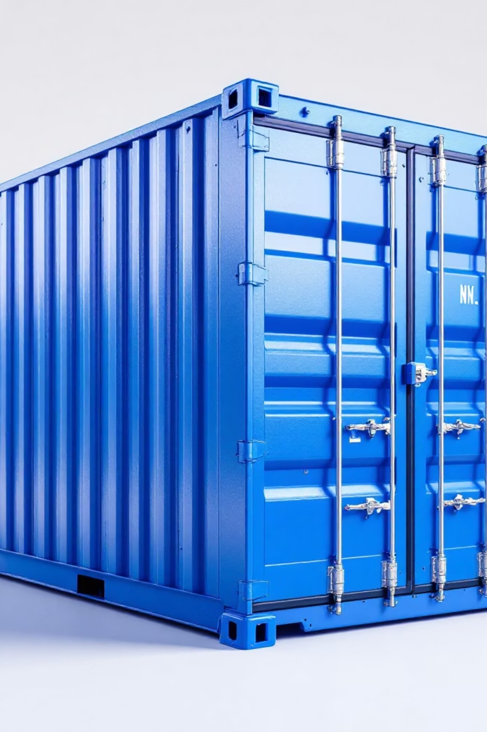
Transborder Freight Analysis: Patterns & Insights
By: Richmond Tetteh
A comprehensive analysis of transborder freight transportation patterns, trade relationships, and economic factors between the United States, Canada, and Mexico.

Slide 2




Description of Tools
Initially, Google Colab was chosen for its accessibility and collaborative features. However, the sheer volume and complexity of the transborder freight dataset presented significant challenges, leading to performance limitations.
Google Colab
Jupyter Notebook
Initial data extraction and merging of large CSV files. Ideal for remote collaboration and accessibility.
Transitioned for robust exploratory data analysis (EDA), intensive data cleaning, advanced visualization, and presentation preparation.
Encountered performance issues with very large datasets, leading to slow operations and notebook crashes.
Provided the stability and computational power needed for complex, large-scale data operations.
This adaptive approach ensured that the project could proceed efficiently, leveraging the strengths of each platform for different stages of the data pipeline.

Slide 3

Dataset Processing Pipeline
My analysis utilized transborder freight data sourced from Thinkific's OneDrive, undergoing a meticulous multi-stage processing pipeline to ensure data integrity and usability.
Initial Zip File Splitting
The main large zip file was segmented into smaller archives to enhance processing efficiency and reduce runtime.
Nested Zip Extraction
An automated routine iterated through and extracted content from numerous nested zip files into dedicated directories.
CSV Identification & Merging
All identified CSV files were loaded into pandas DataFrames and then concatenated into a single, comprehensive dataset.
Data Assessment & Cleaning
Initial data assessments (shape, dtypes, descriptive statistics) guided extensive cleaning, refining the dataset for analysis.
Data Saving & Cleanup
The consolidated DataFrame was saved as combined_data.csv, followed by the deletion of all intermediate files to optimize storage.
The dataset was transformed from an initial 36.3 million entries and 15 features to a refined 25.9 million entries and 11 key features, focusing on relevant categorical and numeric variables like value, ship weight, and freight charges.

Slide 4
Key Questions Addressed
My analysis provided answers to my critical questions about transborder freight operations, offering a comprehensive view of patterns and insights:
Trade & Country Dominance
Merchandise & Packaging
Transportation Logistics
Analyzed preferred merchandise types and predominant freight packaging methods.
Examined the most utilized transportation modes and their application across various trade types.
Identified the most used trade types and the countries with the highest trade activity.
Cost & Correlation Insights
Country-Specific Nuances
Uncovered seasonal patterns in freight costs and their correlations with ship weight and value.
Detailed packaging and trade type preferences unique to each participating country.

Slide 5
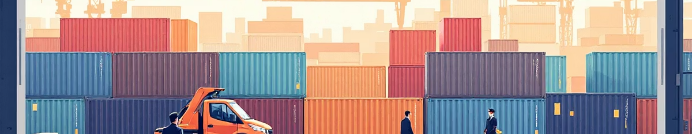
Trade Type Distribution
695,731
304,269
Export Transactions
Import Transactions
Exports dominated transborder freight activity
Significantly fewer import transactions recorded

Slide 6
Country Trade Activity
62%
38%
Canada
Mexico
Canada dominated transborder freight activity with 621,269 transactions
Mexico recorded 378,731 transactions
Canada remains the primary trade partner for transborder freight transportation.

Slide 7

Merchandise & Packaging Analysis
Merchandise Origin
Domestically produced: 762,928
Foreign produced: 237,072
Packaging Method
Non-containerized: 602,515
Containerized: 397,485

Slide 8








Transportation Types
Trucks
Air
704,757 shipments
Second most common
Mail
Rail
Only 465 shipments
Third most common
Trucks overwhelmingly dominate transborder freight transportation.

Slide 9
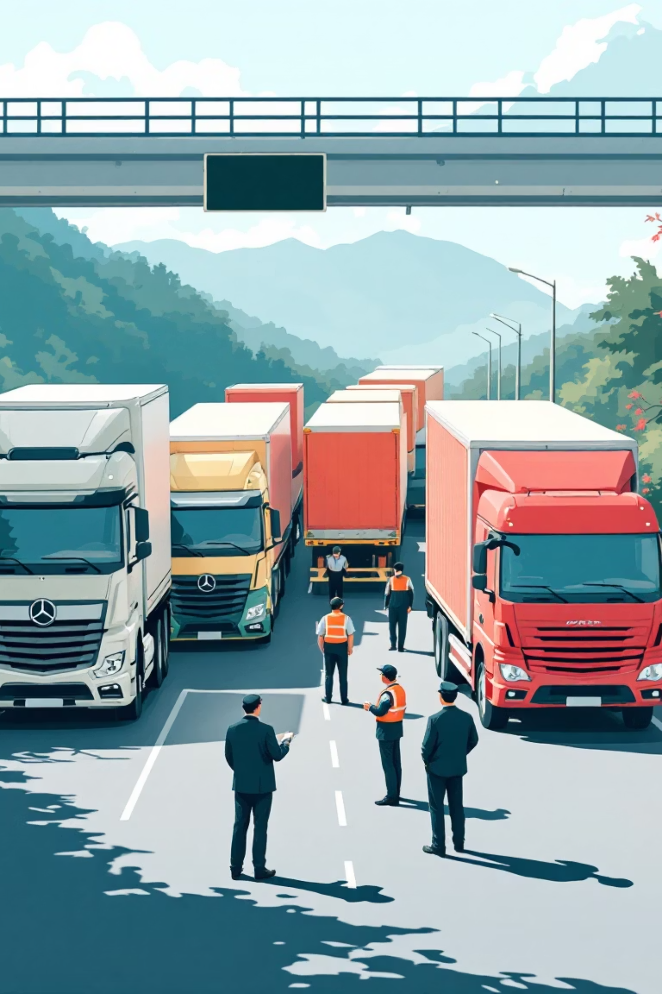

Transportation by Trade Type
Almost all transportation modes were used primarily for exports rather than imports, with one exception:
Foreign Trade Zones (FTZs) were exclusively used for imports with zero export activity.
Trucks remained dominant with 502,772 export shipments versus 201,985 import shipments.

Slide 10
Top Commodities Transported by Truck
1
Nuclear reactors, boilers, machinery and mechanical appliances
2
Electrical machinery and equipment
3
Plastics and articles thereof
4
Vehicles and parts (non-railway)
5
Optical, photographic, medical instruments

Slide 11



Seasonal Patterns in Freight Costs
2020-2022
Mean freight charges increased, peaking in 2022
2022-2024
Charges dropped in 2023 and continued falling in 2024 (with some exceptions)
Recommendation: Review freight charges to ensure business profitability

Slide 12
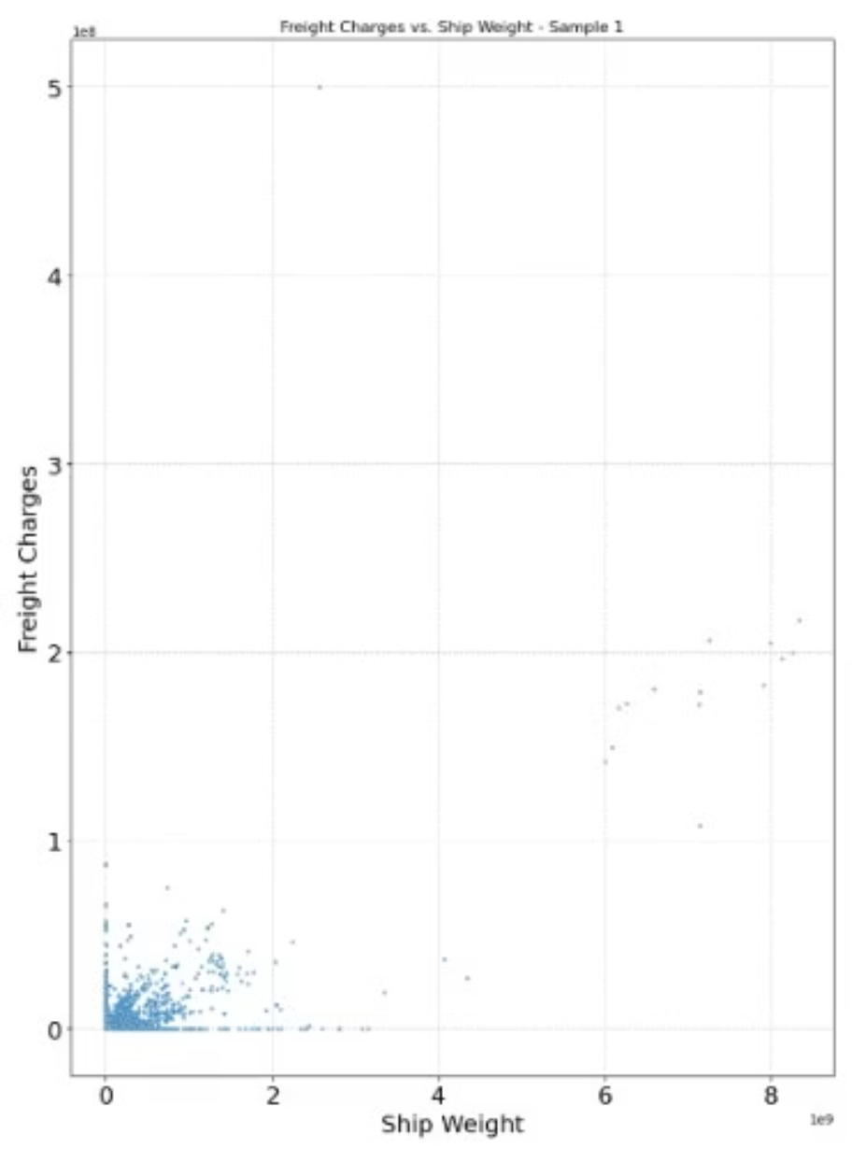
Correlations Between Key Metrics
Key Findings:
Strong positive correlation between ship weight and freight charges
Moderate positive correlation between ship weight and value
Moderate positive correlation between freight charges and value
Most data points cluster near the origin, suggesting potential for further analysis.

Slide 13

Country-Specific Packaging Patterns
Canada Exports
1
All containerized (385,169 shipments)
Canada Imports
2
All non-containerized (236,616 shipments)
Mexico Exports
3
Mostly containerized (296,774) with some non-containerized (13,840)
Mexico Imports
4
All non-containerized (68,705 shipments)

Slide 14




Summary of Key Insights from Analysis
Truck-Dominant North American Trade
Dynamic Freight Cost Landscape
Transborder freight is overwhelmingly driven by truck transport, with Canada being the primary trade partner for both exports and imports, highlighting the importance of efficient road logistics.
Freight charges experienced significant fluctuations, peaking in 2022 and declining thereafter, underscoring the need for continuous monitoring and adaptive pricing strategies.
Country-Specific Logistics Nuances
Interconnected Metrics & Opportunities
Distinct packaging preferences exist between Canada and Mexico, particularly regarding containerized versus non-containerized shipments, necessitating tailored logistics approaches.
Strong correlations between ship weight, value, and freight charges suggest deeper analysis can reveal further optimization and cost-saving opportunities across the supply chain.

Slide 15
Recommendations for Business Improvement
Strategic Cost Management
Optimize Logistics Processes
Deepen Data Analytics
Leverage seasonal freight cost patterns to implement dynamic pricing and shipping strategies, ensuring maximum profitability and competitive rates.
Conduct further analysis on correlations between ship weight, value, and freight charges to uncover additional cost-saving opportunities and demand insights.
Streamline packaging methods based on country-specific patterns (e.g., increased containerization for Canada exports) and enhance truck freight efficiency.
These actions can lead to improved operational efficiency and increased profitability in transborder freight operations.

